Slide 1
ATAI
Advanced Techniqueof Artificial Intelligence
ATAI
ChongqingUniversity _{AdvancedTechniqueof}
of Technology Artificial Intelligence
Chongqing University of
Technology
Chongqing University ^{ATAI}
_{of Technology} Advanced Techniqueof
Artificial Intelligence
Chongqing University of Technology
Chongqing University of Technology
Semi-IIN: Semi-supervised Intra-inter modal Interaction Learning Network for Multimodal Sentiment Analysis
Code:https://github.com/flow-ljh/Semi-IIN
2025.2.27 •ChongQing
—— AAAI 2025
Reported by YaoChen Li
1

Slide 2
ATAI
AdvancedTechniqueof
Artificial Intelligence
ATAI
ChongqingUniversity _{AdvancedTechniqueof}
of Technology Artificial Intelligence
ChongqingUniversity of Technology
Motivation
(1)In the context of multimodal interactions with unlabeled data, current methods struggle to incorporate sentiment-related features from unlabeled data.
(2)The intensity of intra-modal and inter-modal interactions may be different for different samples, so how to effectively model these interactions has become a key challenge.

Slide 3
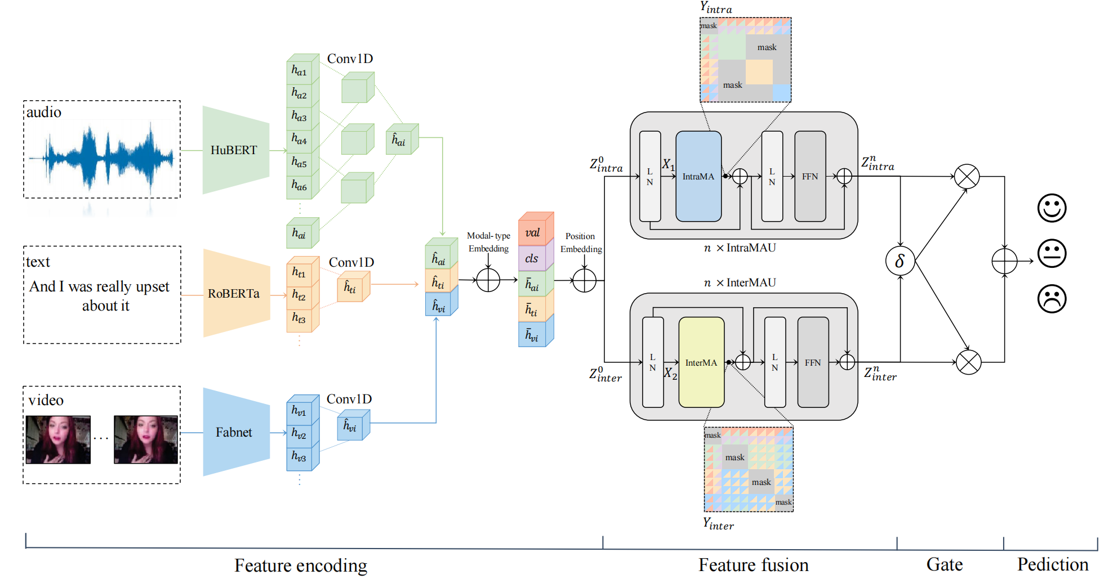
ChongqingUniversity of Technology
ATAI
AdvancedTechniqueof
Artificial Intelligence
ATAI
ChongqingUniversity _{AdvancedTechniqueof}
of Technology Artificial Intelligence
Overview

Slide 4
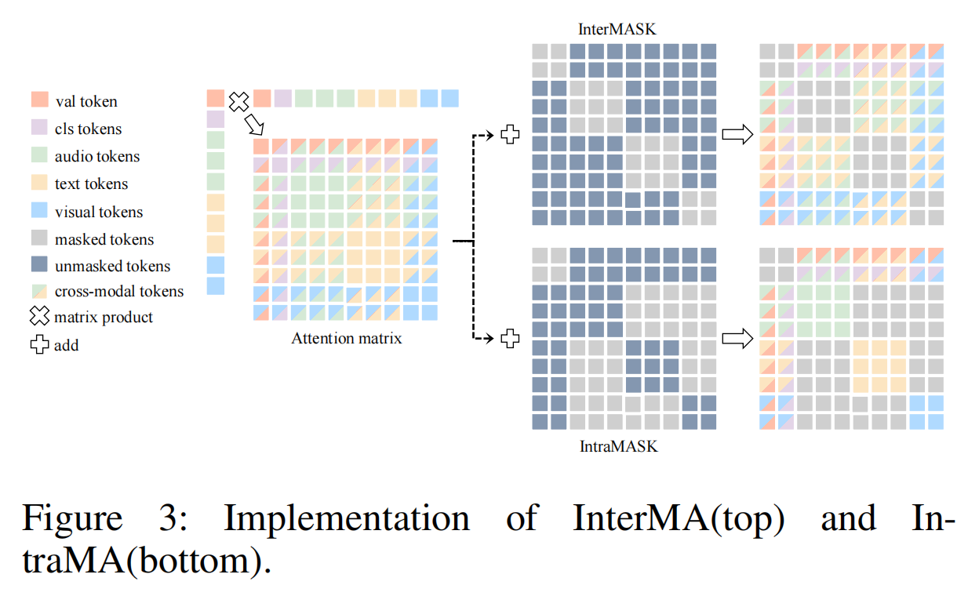
ChongqingUniversity of Technology
ATAI
AdvancedTechniqueof
Artificial Intelligence
ATAI
ChongqingUniversity _{AdvancedTechniqueof}
of Technology Artificial Intelligence
Overview

Slide 5
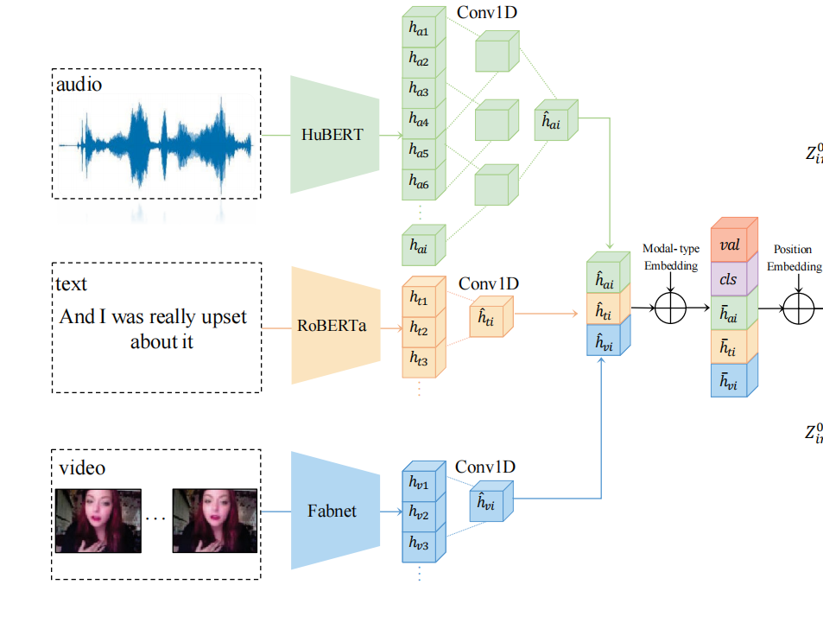
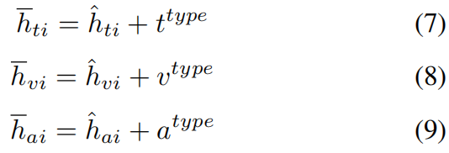
ChongqingUniversity of Technology
ATAI
AdvancedTechniqueof
Artificial Intelligence
ATAI
ChongqingUniversity _{AdvancedTechniqueof}
of Technology Artificial Intelligence
Method

Slide 6
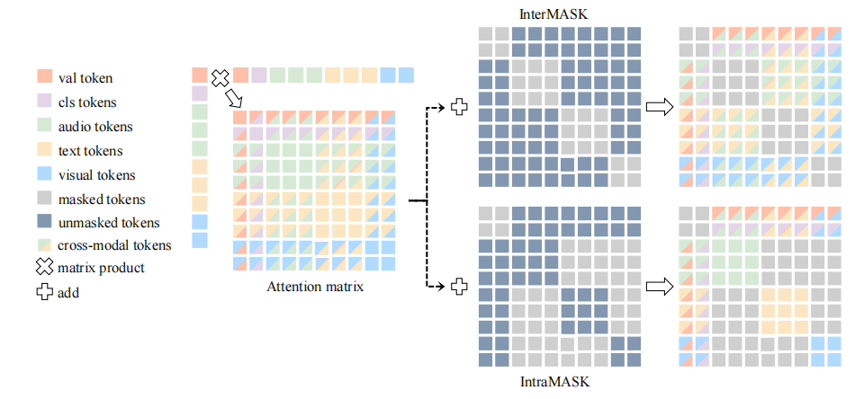
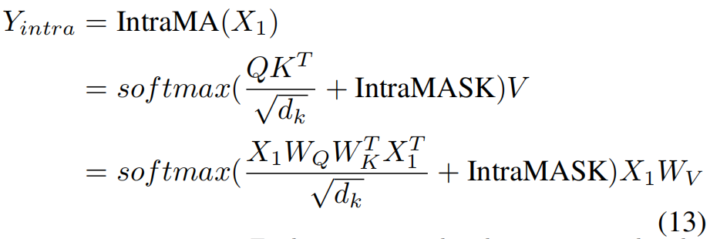
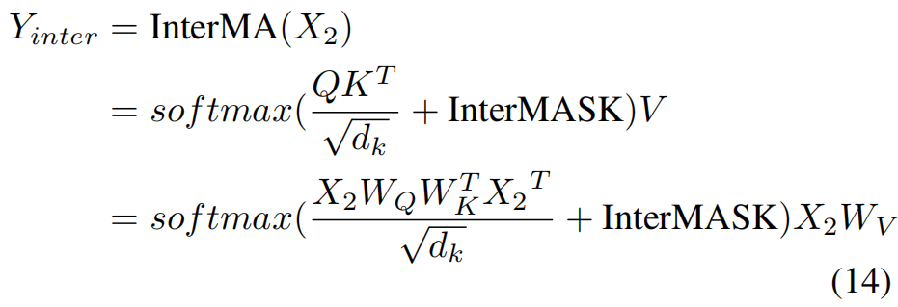
ChongqingUniversity of Technology
ATAI
AdvancedTechniqueof
Artificial Intelligence
ATAI
ChongqingUniversity _{AdvancedTechniqueof}
of Technology Artificial Intelligence
Method

Slide 7
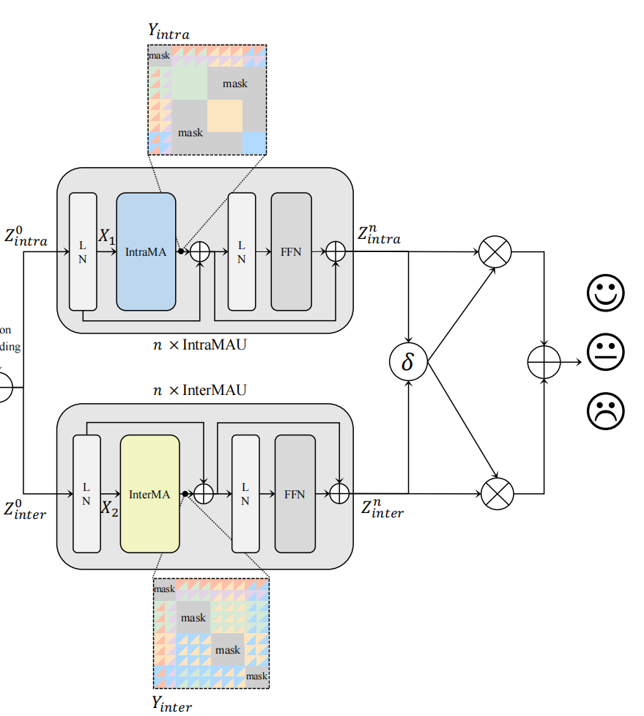
ChongqingUniversity of Technology
ATAI
AdvancedTechniqueof
Artificial Intelligence
ATAI
ChongqingUniversity _{AdvancedTechniqueof}
of Technology Artificial Intelligence
Method

Slide 8
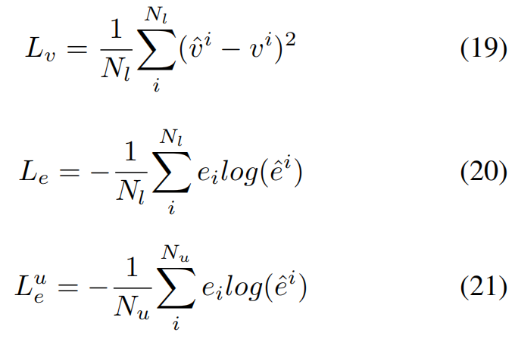
ChongqingUniversity of Technology
ATAI
AdvancedTechniqueof
Artificial Intelligence
ATAI
ChongqingUniversity _{AdvancedTechniqueof}
of Technology Artificial Intelligence
Method

Slide 9
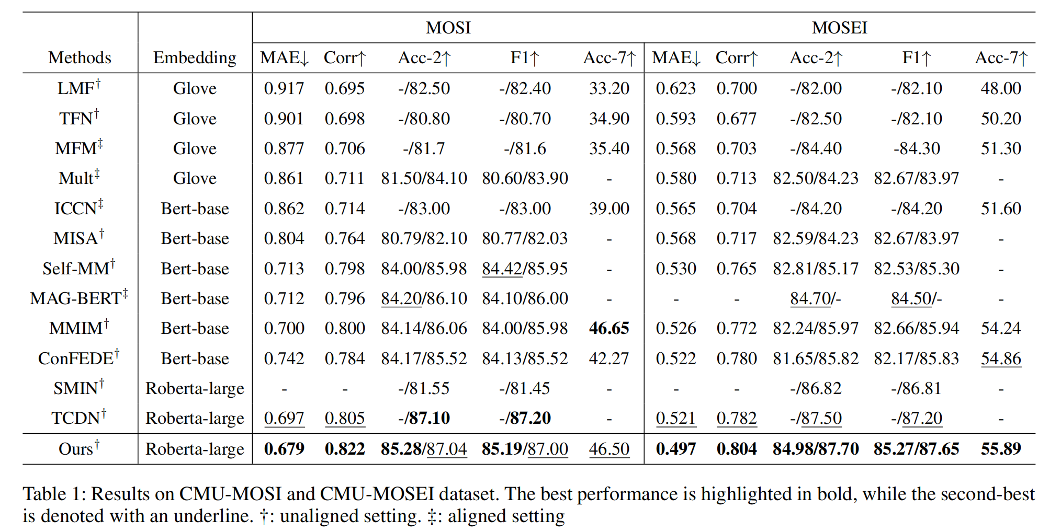
ATAI
AdvancedTechniqueof
Artificial Intelligence
ATAI
ChongqingUniversity _{AdvancedTechniqueof}
of Technology Artificial Intelligence
ChongqingUniversity of Technology
Experiments

Slide 10
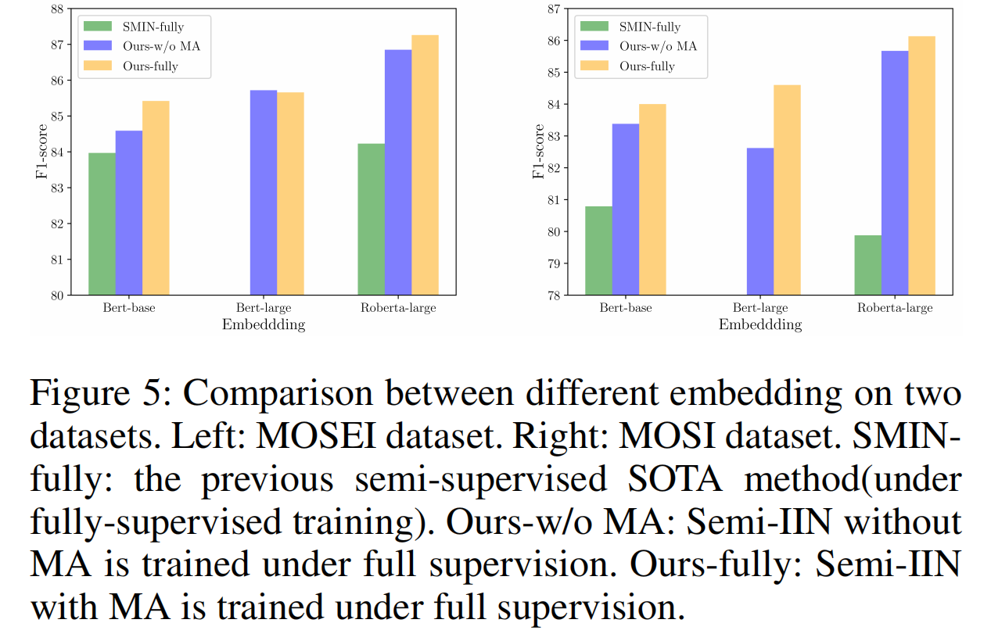
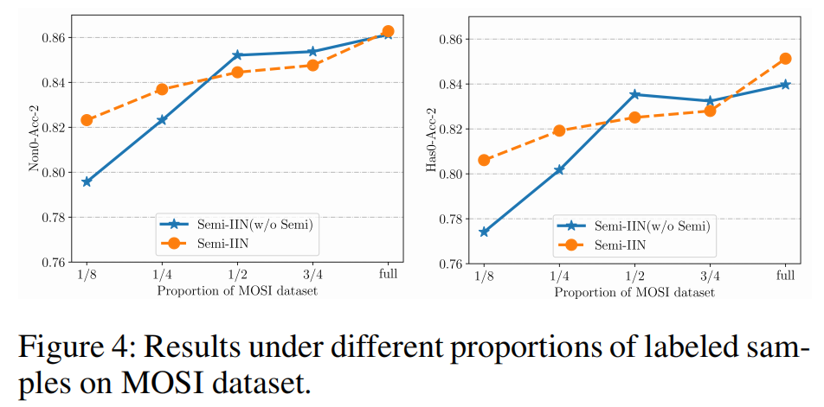
ATAI
AdvancedTechniqueof
Artificial Intelligence
ATAI
ChongqingUniversity _{AdvancedTechniqueof}
of Technology Artificial Intelligence
ChongqingUniversity of Technology
Experiments

Slide 11
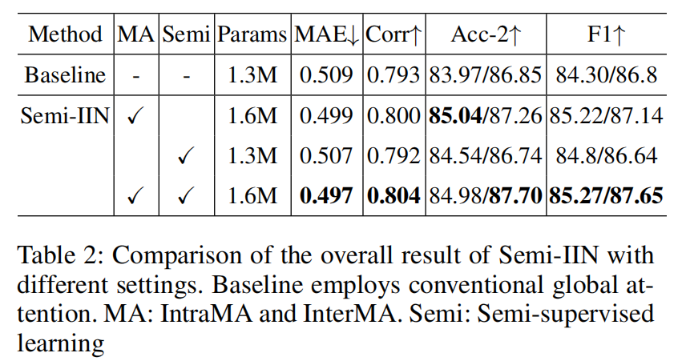
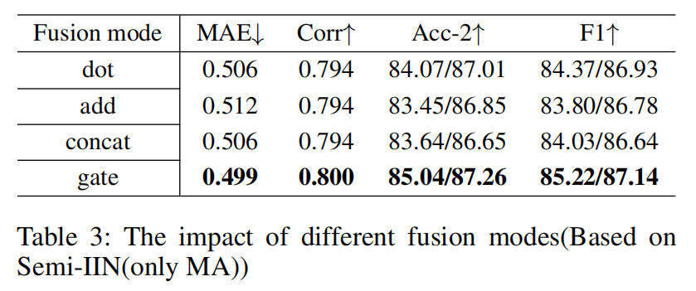
ChongqingUniversity of Technology
ATAI
AdvancedTechniqueof
Artificial Intelligence
ATAI
ChongqingUniversity _{AdvancedTechniqueof}
of Technology Artificial Intelligence
Experiments

Slide 12
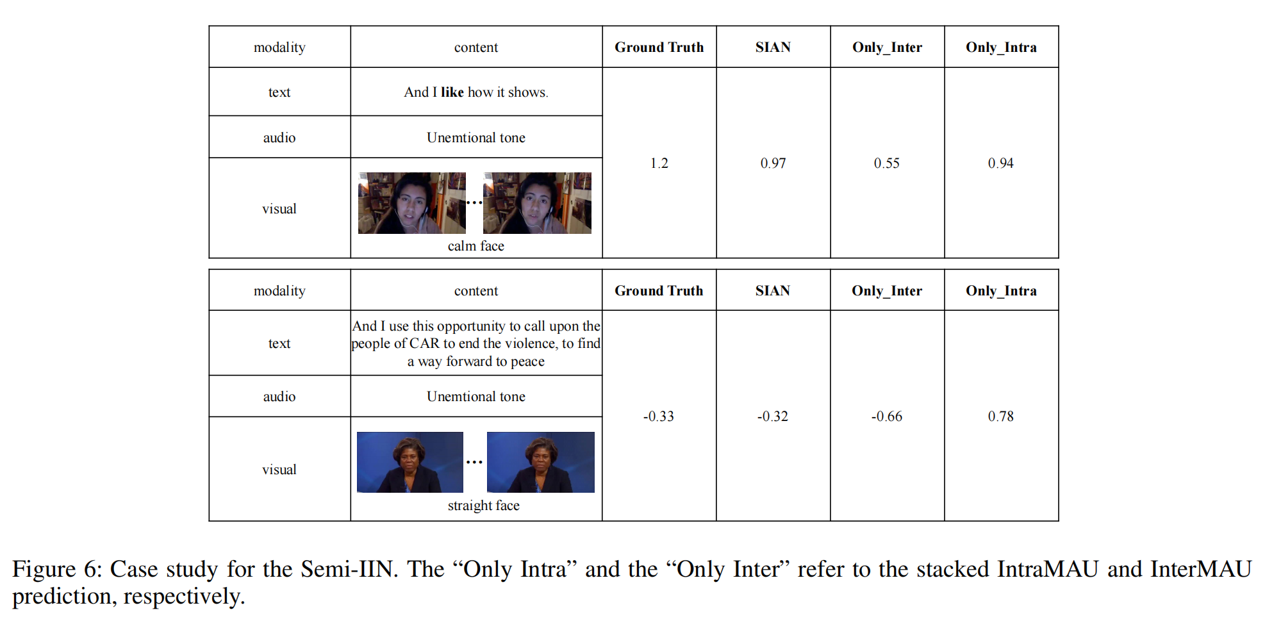
ChongqingUniversity of Technology
ATAI
AdvancedTechniqueof
Artificial Intelligence
ATAI
ChongqingUniversity _{AdvancedTechniqueof}
of Technology Artificial Intelligence
Experiments

Slide 13
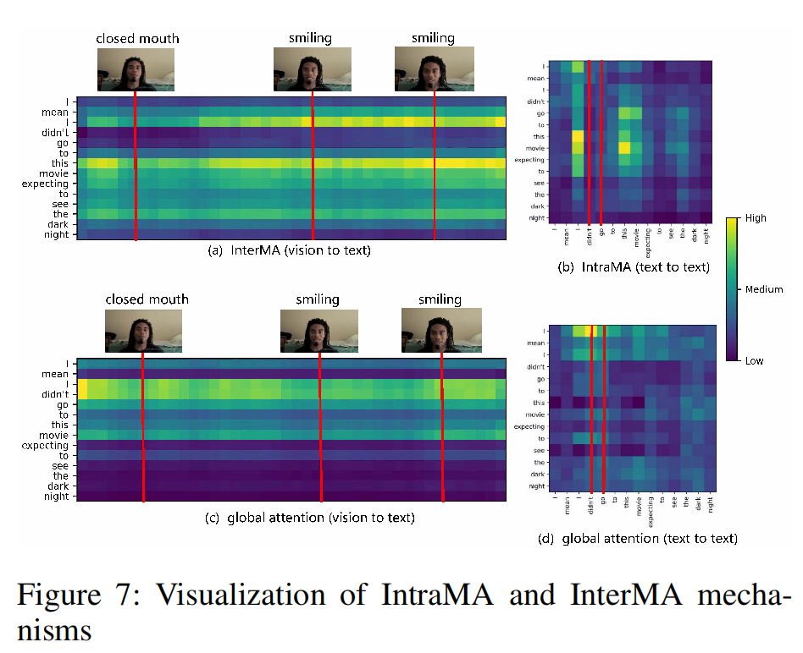
ChongqingUniversity of Technology
ATAI
AdvancedTechniqueof
Artificial Intelligence
ATAI
ChongqingUniversity _{AdvancedTechniqueof}
of Technology Artificial Intelligence
Experiments

Slide 14
ChongqingUniversity of Technology
ATAI
AdvancedTechniqueof
Artificial Intelligence
ATAI
ChongqingUniversity _{AdvancedTechniqueof}
of Technology Artificial Intelligence
Thanks!

